Slide 1

Customer Discovery
WEEK EIGHT
CEO: Rachel Evans
CTO: Sophie Tanker
CFO: Andra Buchan

Slide 2
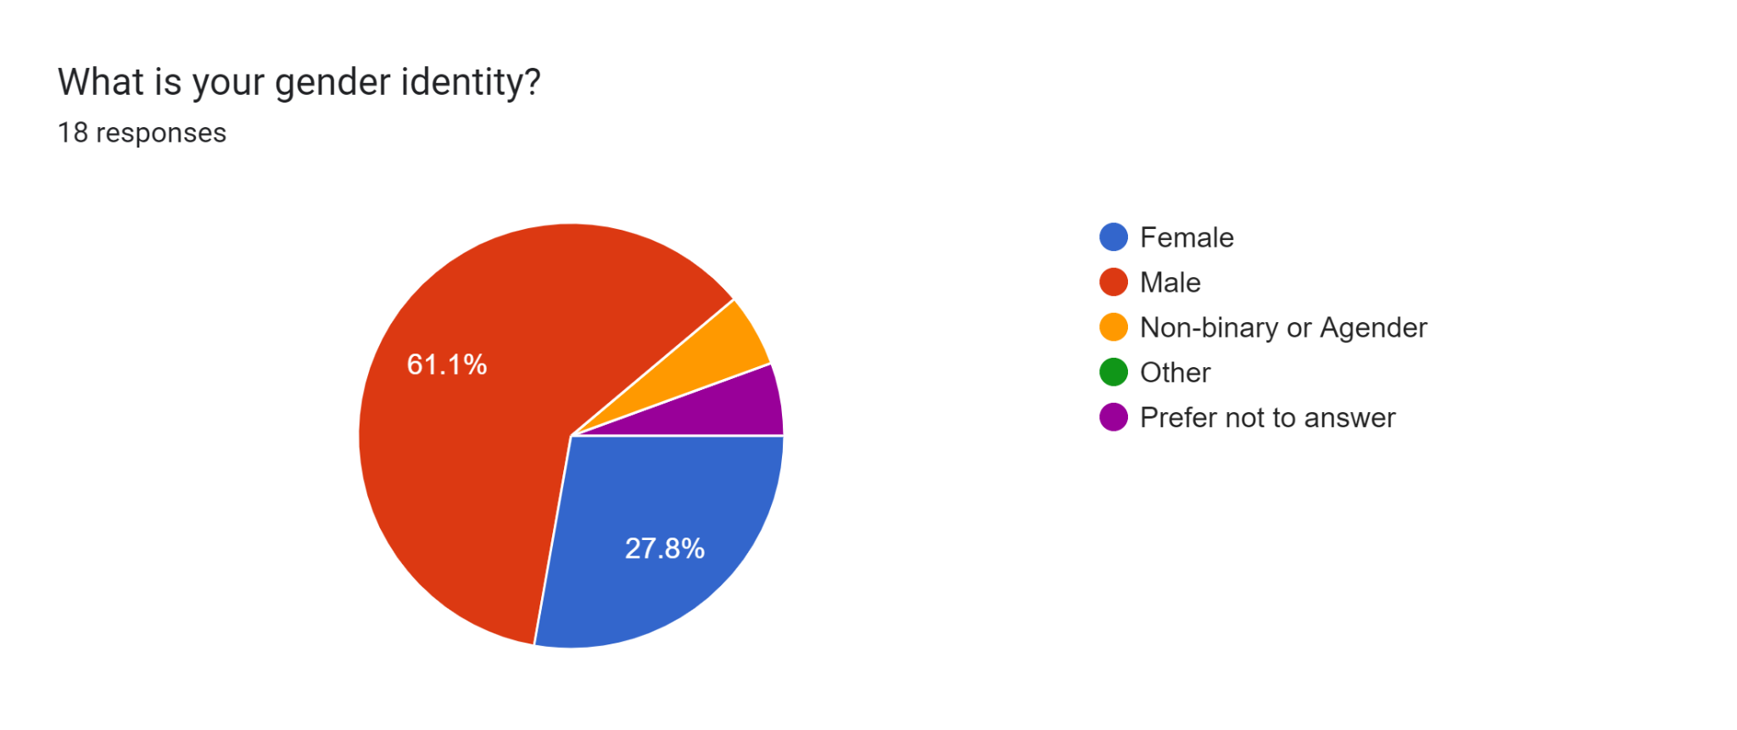
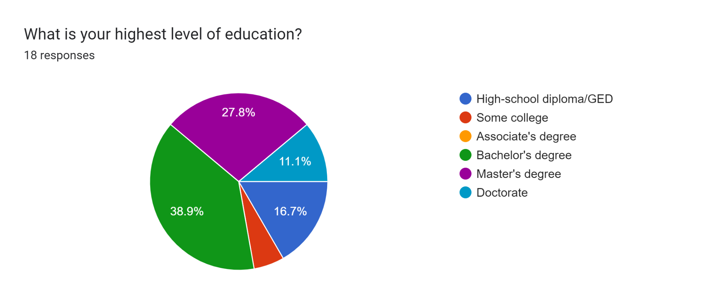
DEMOGRAPHIC INFORMATION

Slide 3
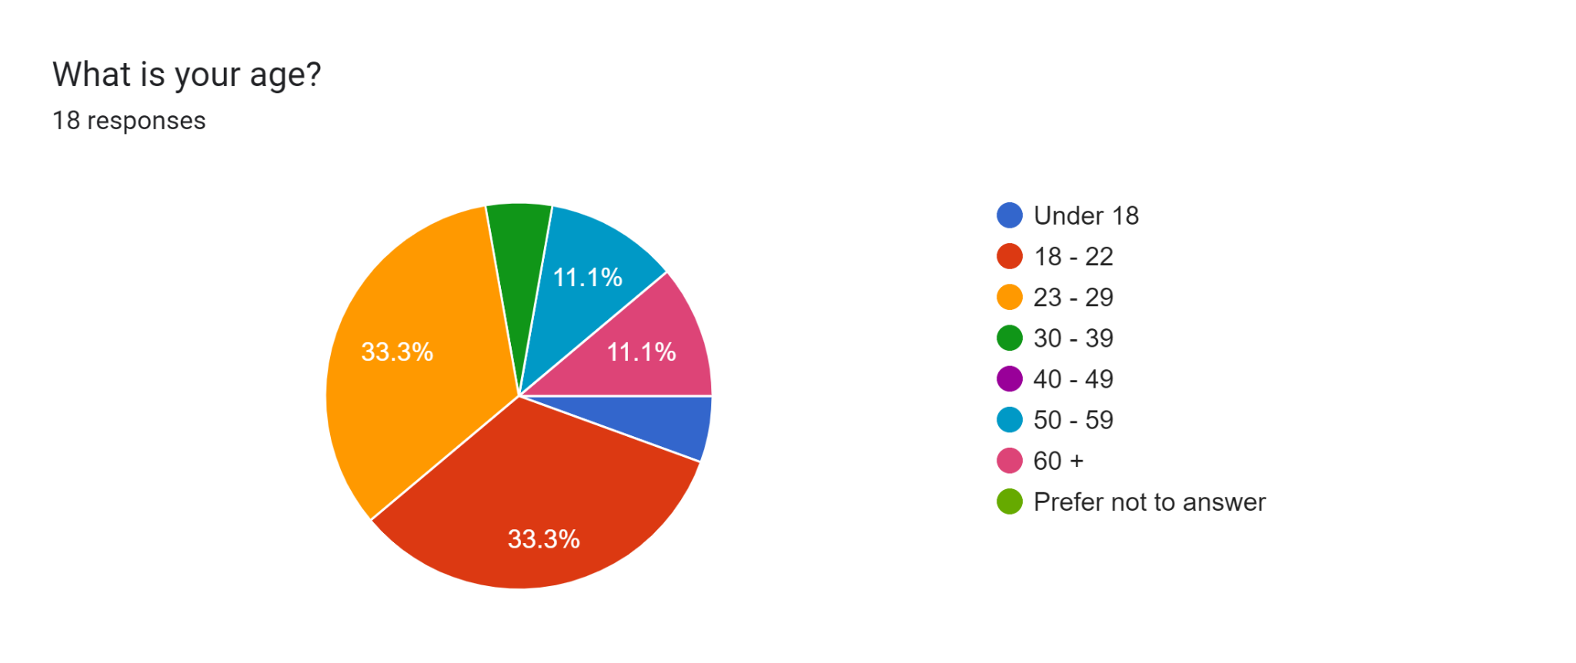
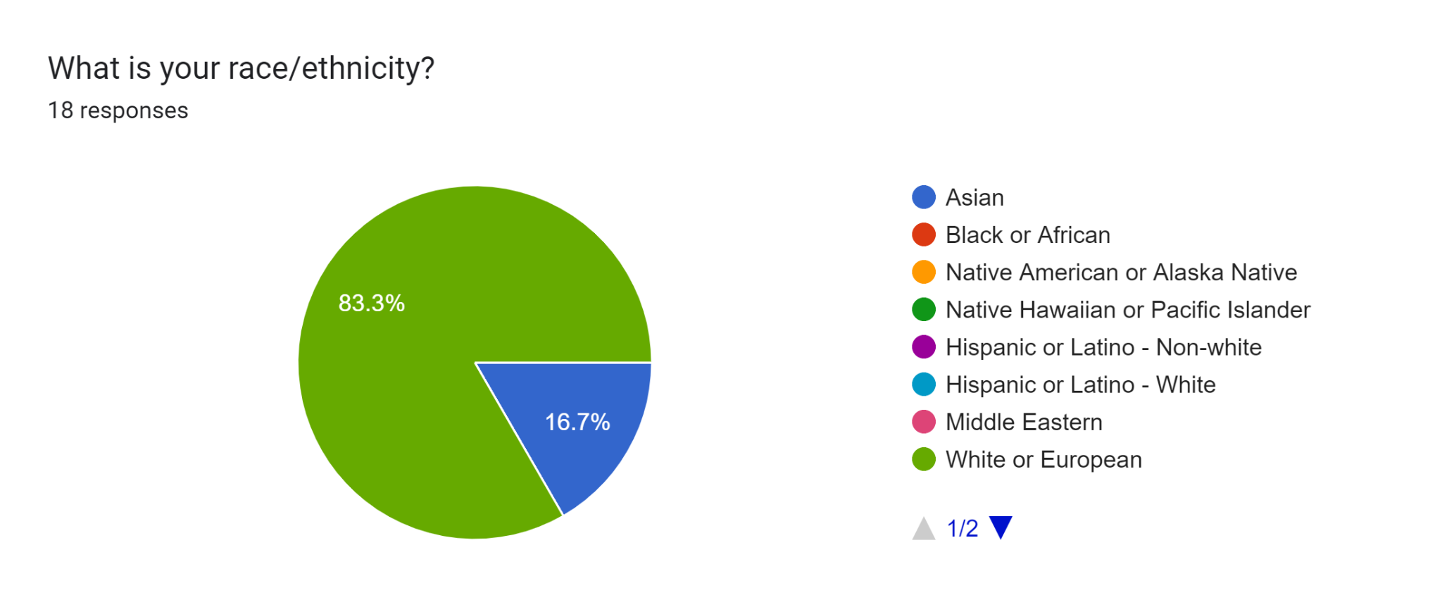
DEMOGRAPHIC INFORMATION

Slide 4
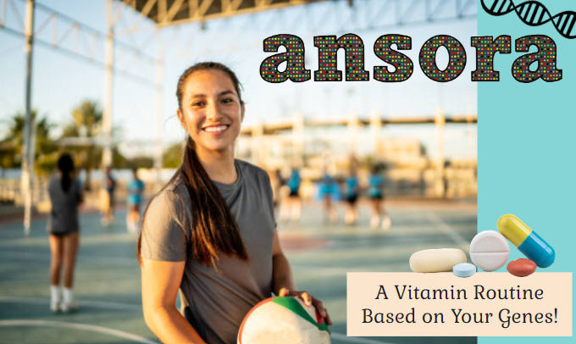
ADVERTISEMENT 1

Slide 5
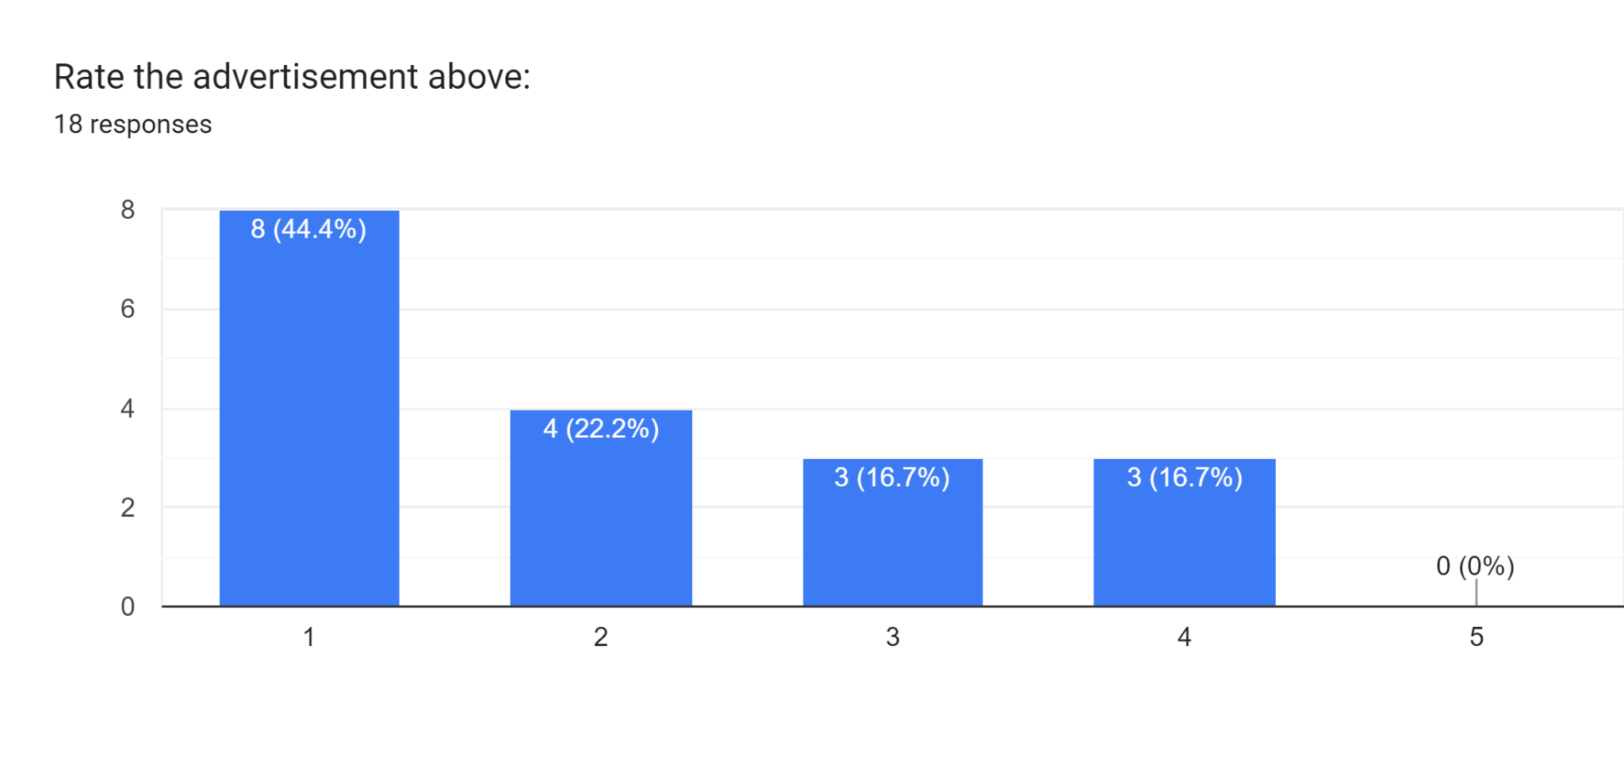
ADVERTISEMENT 1

Slide 6
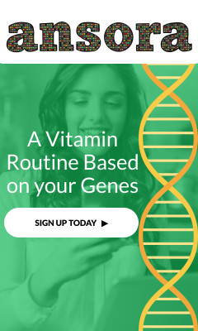
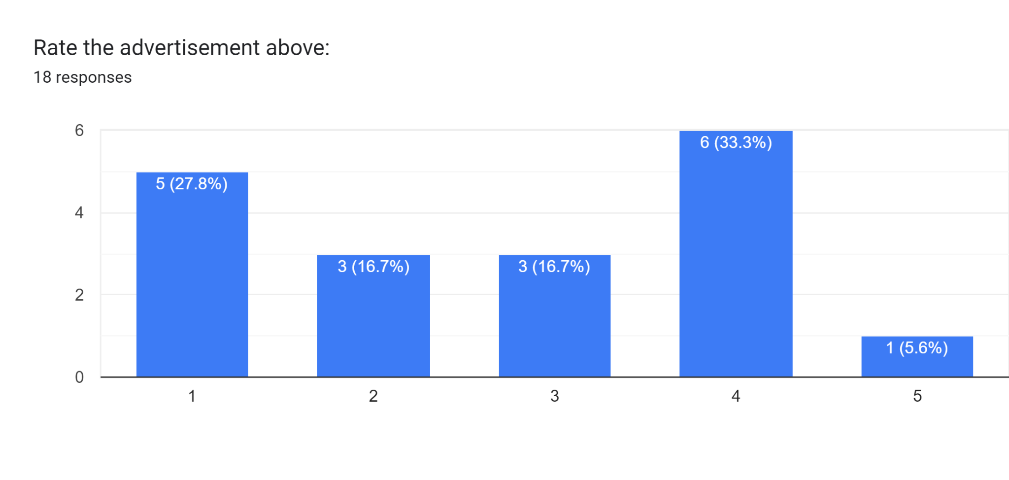
ADVERTISEMENT 2

Slide 7

ADVERTISEMENT 3

Slide 8
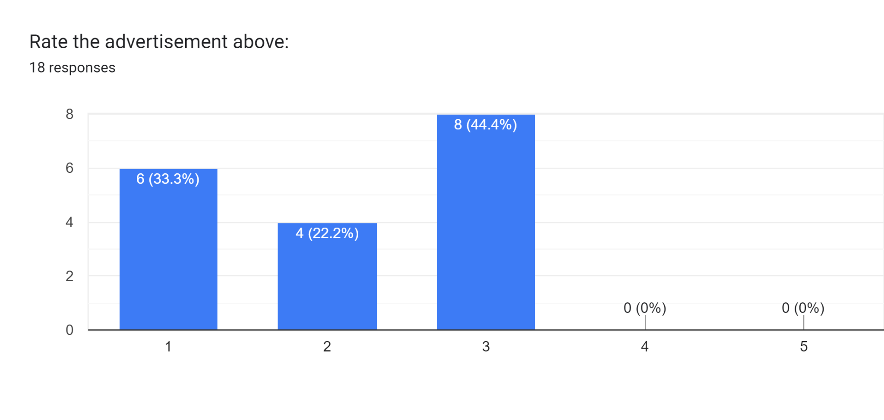
ADVERTISEMENT 3

Slide 9
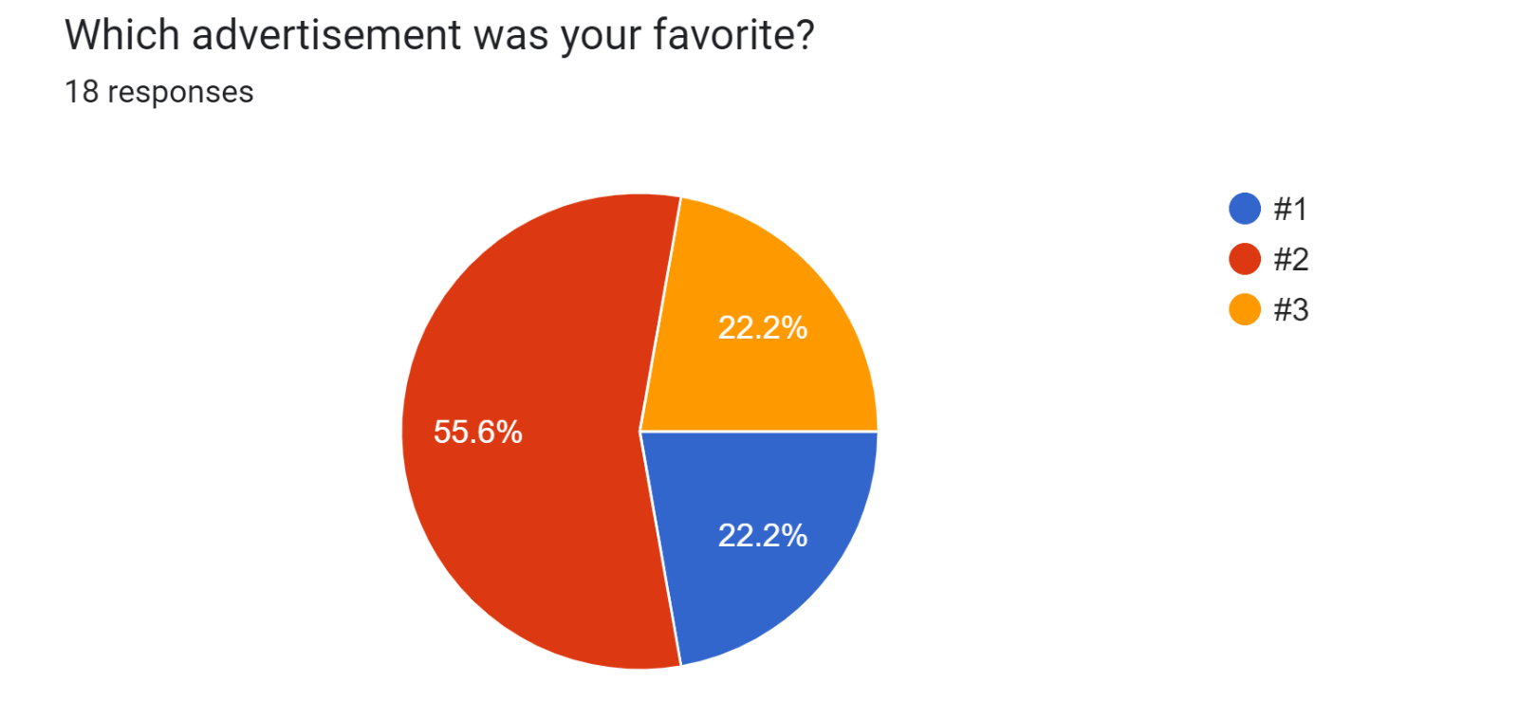

Slide 10
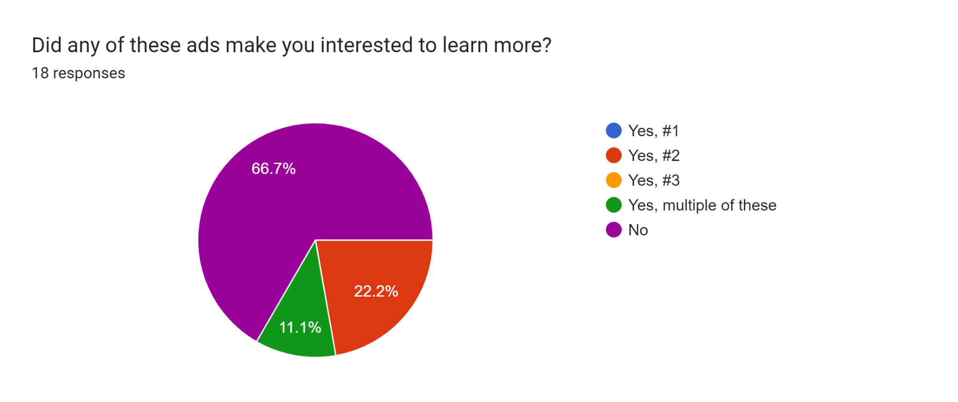

Slide 11
FEEDBACK
1 and 3 look like they're from a slideshow, and 2 looks pretty basic and generic
Advertisement is storytelling. What is company is about, what do you do, what is the product , what do buyer get from buying company product. All but maybe #2 have nothing that say cutting edge genetic tech or getting better health with supplements. The layout are whacky and hard to read, the logo is eye hurting for main population that require supplements like old people with eye problem. Accessibility is very important when it come to making product for health industry. Hire a graphic designer.
I have a BSc. You want science, you push the science. I you want smiling women, you are already losing to your customers

Slide 12
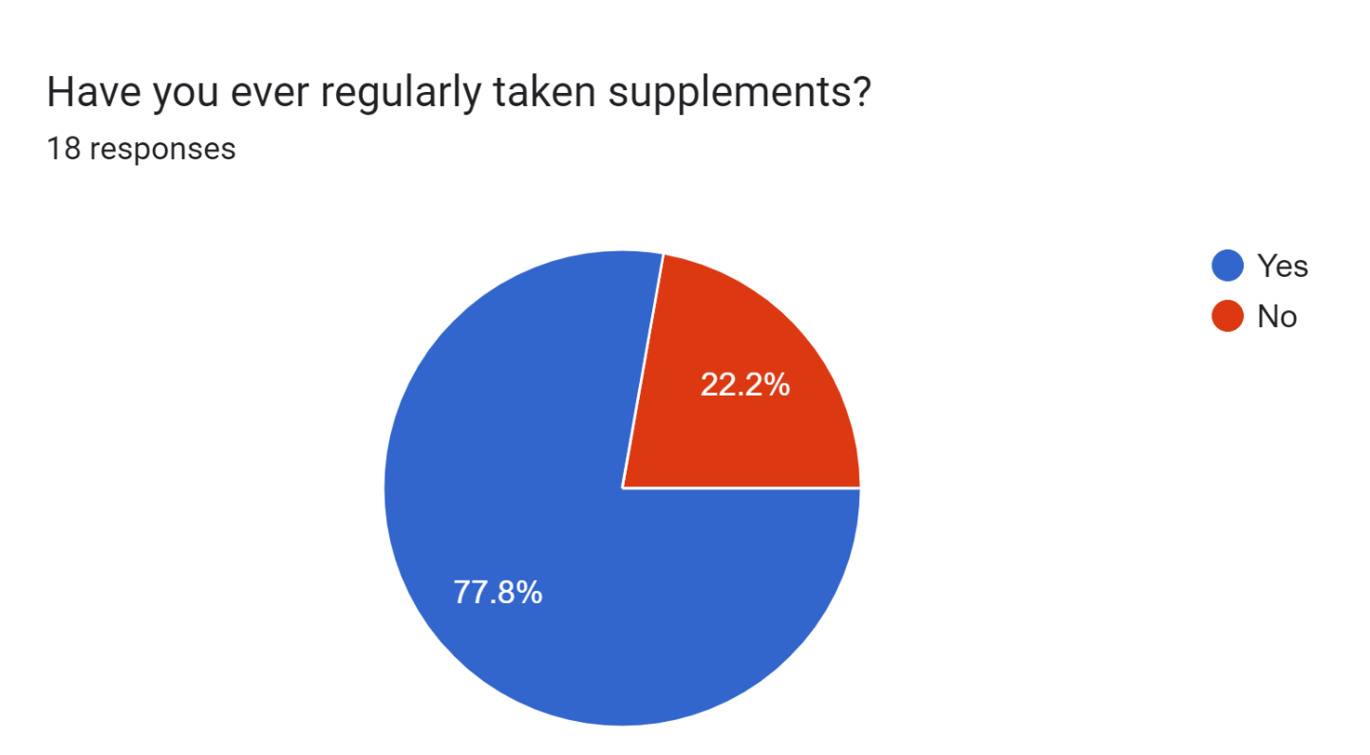
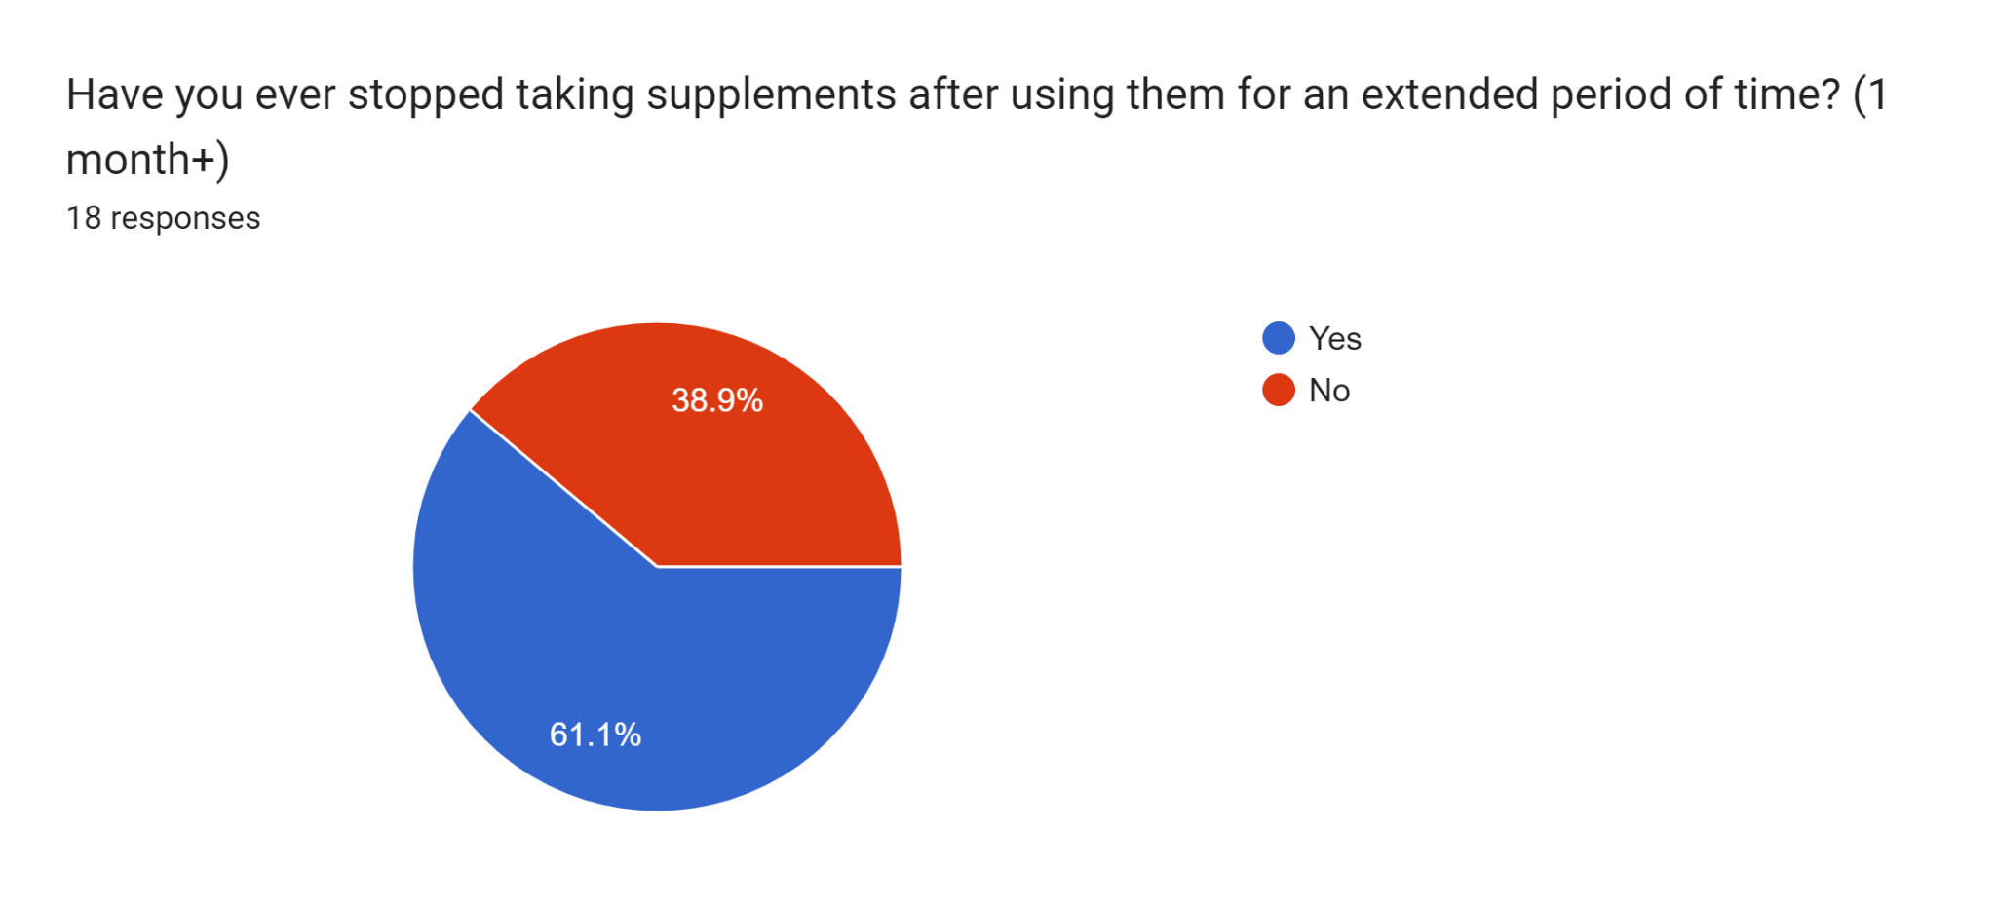

Slide 13
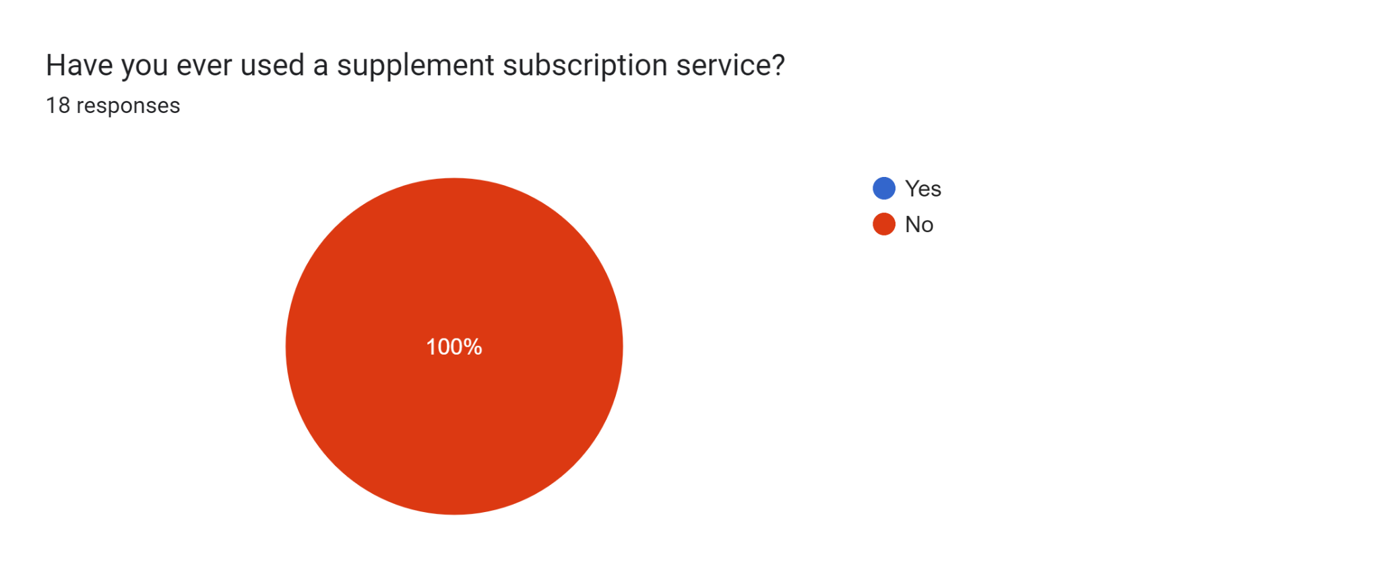
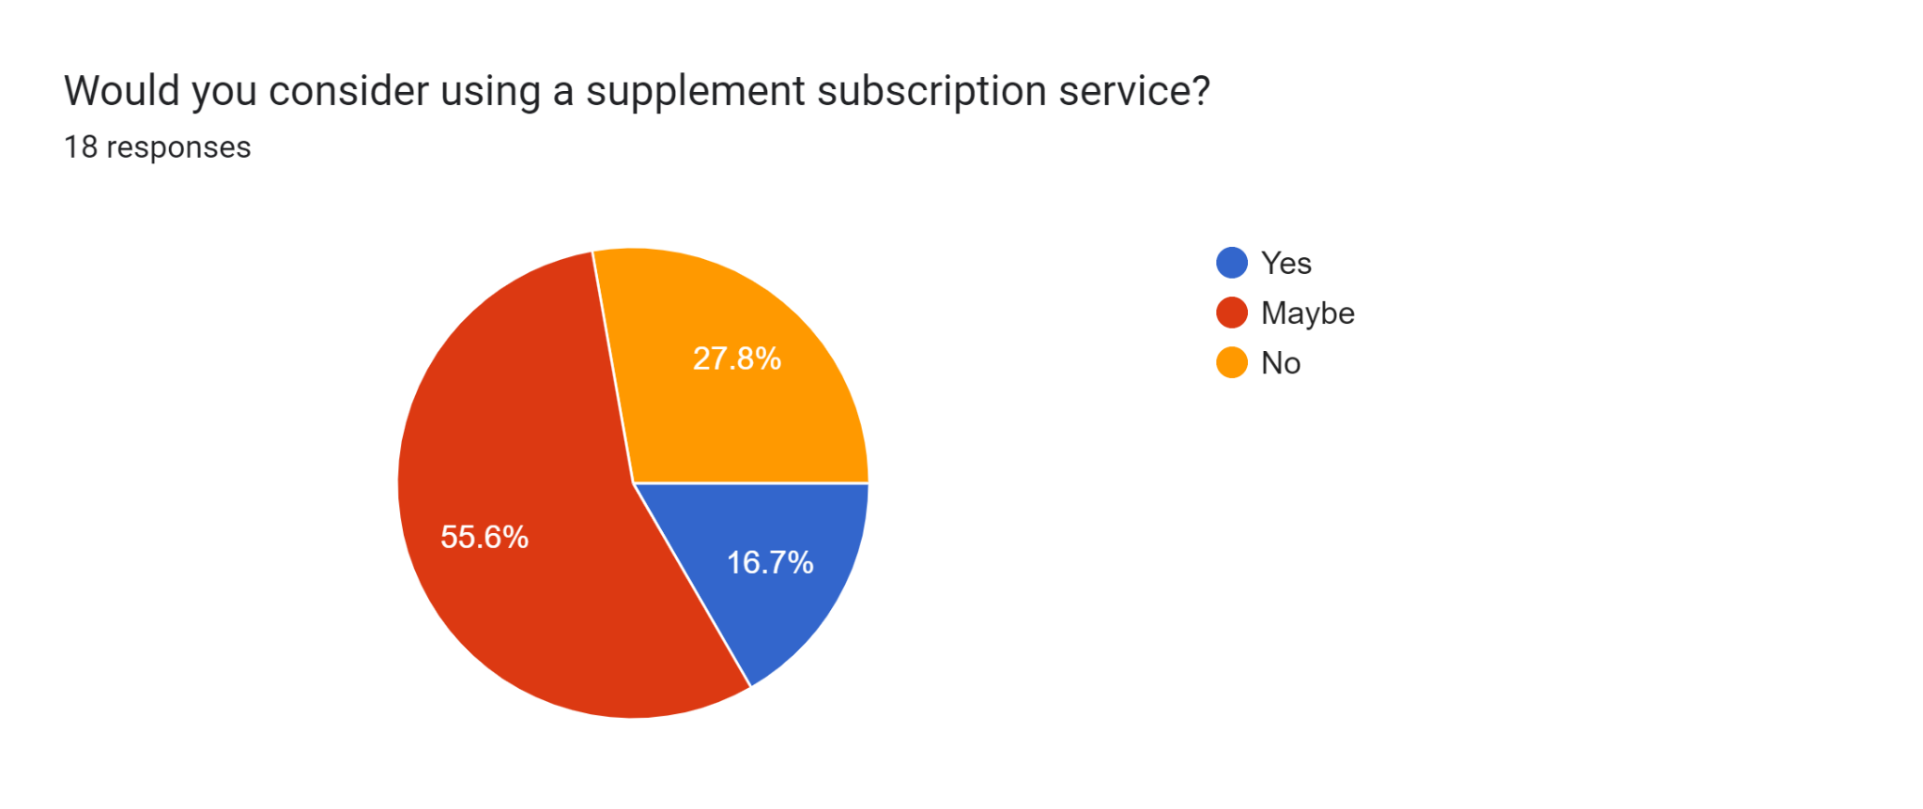

Slide 14
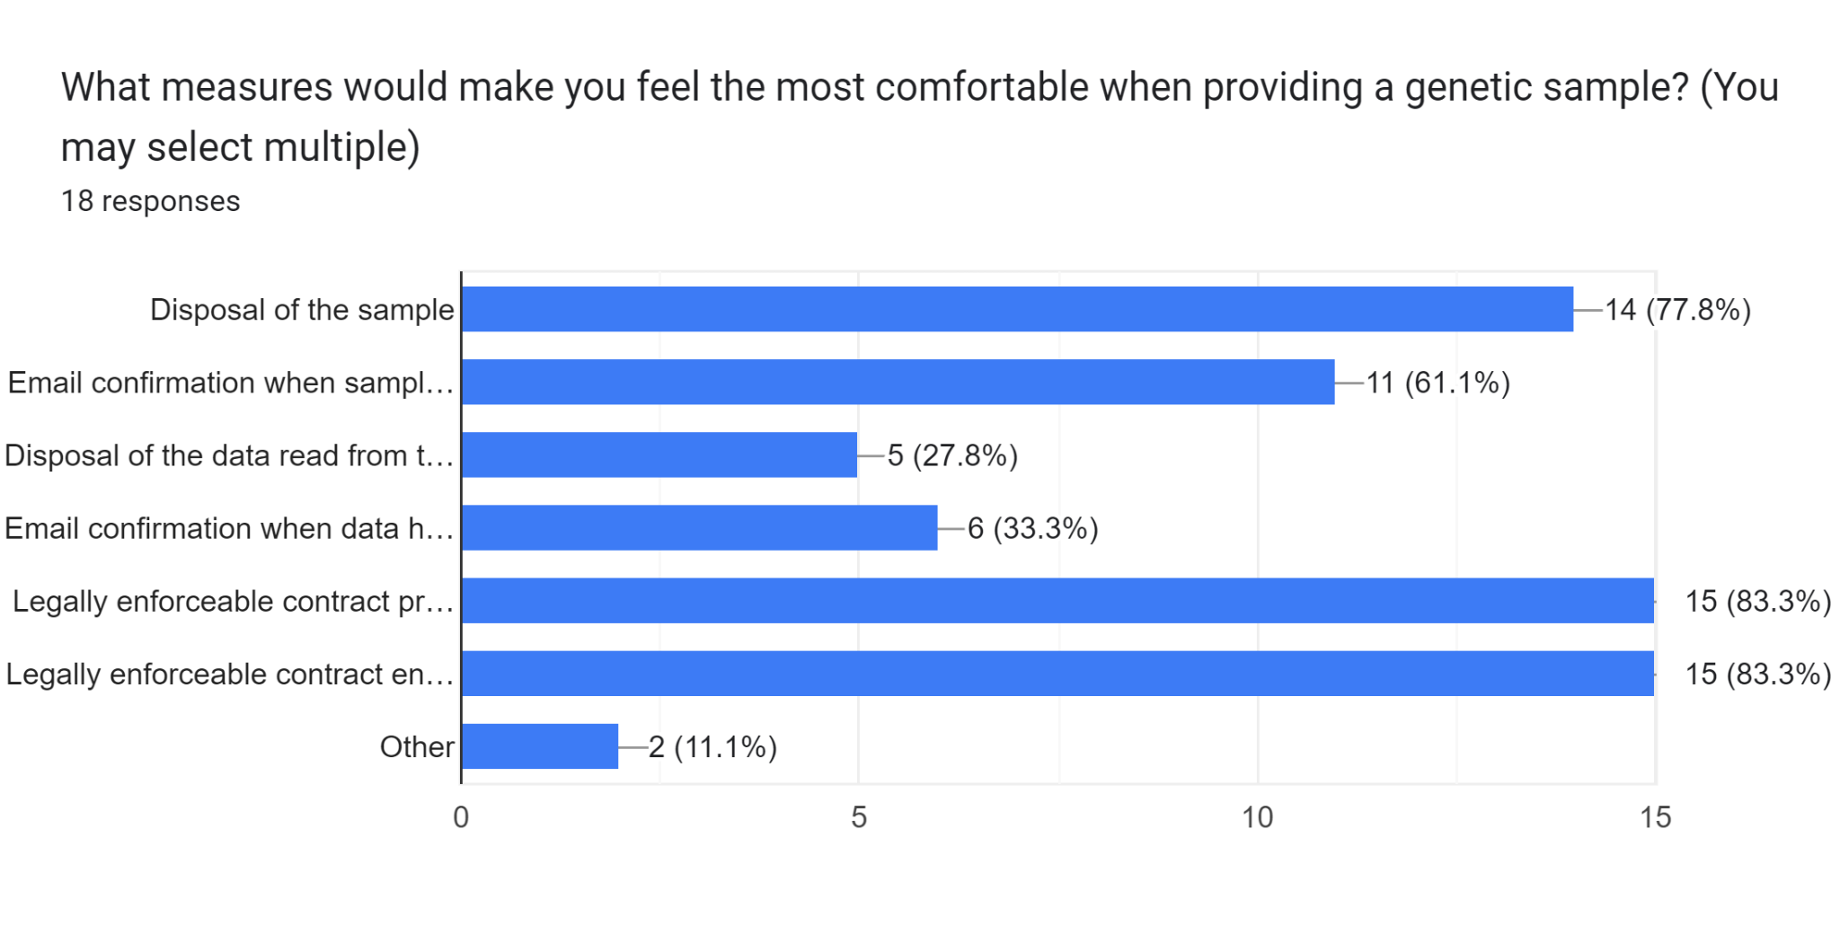

Slide 15
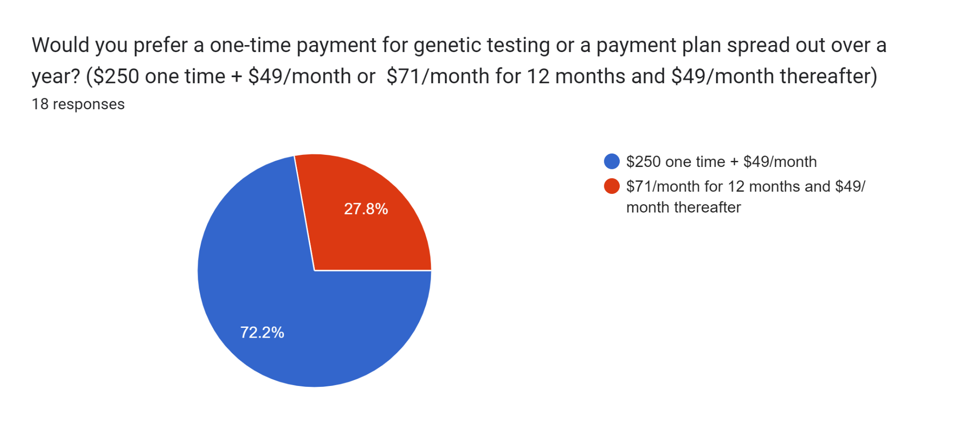

Slide 16

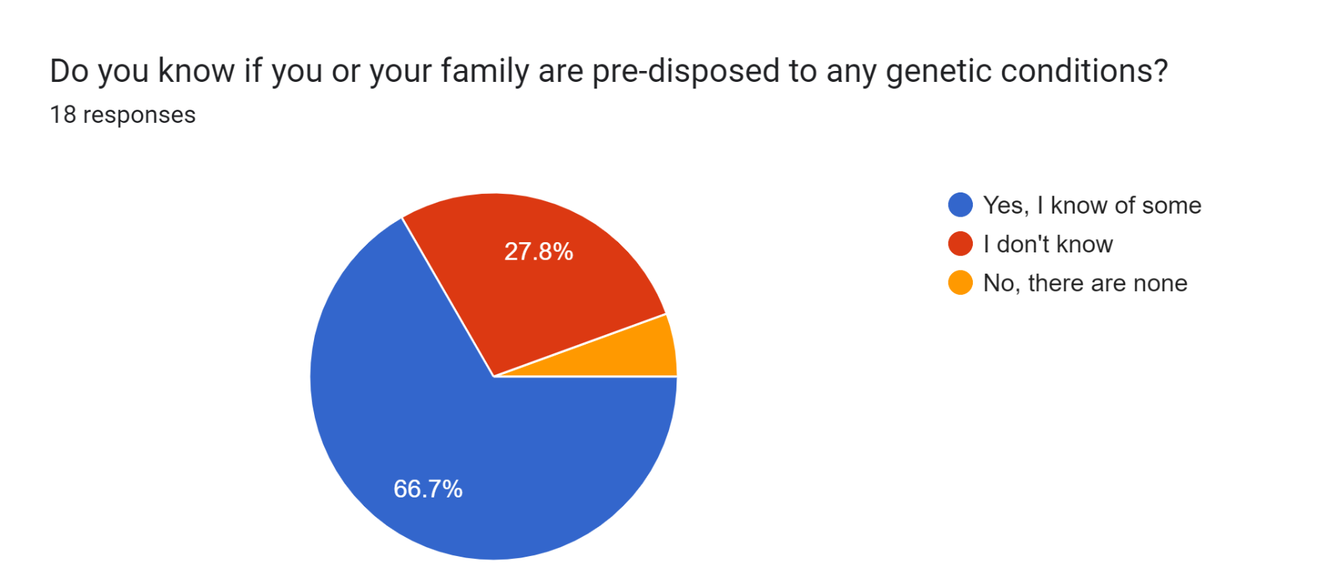
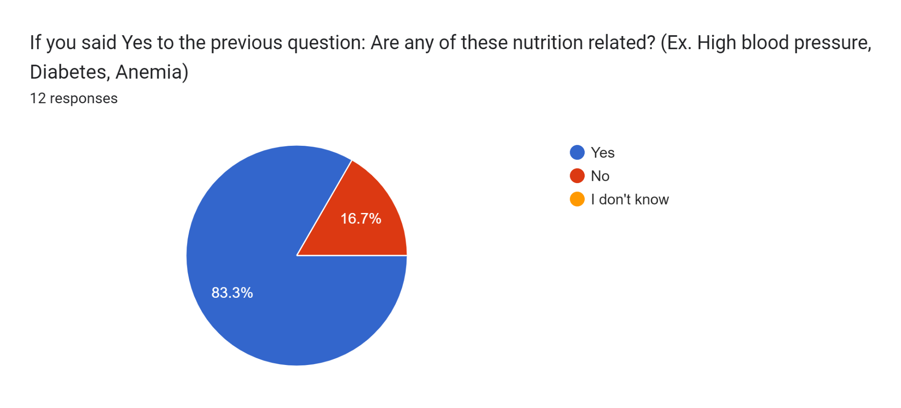
NUTRITION AND FAMILY HISTORY

Slide 17
COMMENTS
I highly doubt that there is robust enough science for your claim that you can personalise nutrition in any meaningful way from gene sampling
This service is a scam designed to make money off of vulnerable people ❤️
I’m sorry but I really don’t think this is a good idea. There are much more important factors that determine whether a person needs supplements than genetics such as activity level, nutrition, food allergies, pregnancy, weight, etc. It could even be dangerous as people really shouldn’t be overtaking supplements.
Everyone seem to do subscription model nowadays

Slide 18
TAKEAWAYS
People on Reddit love the word pseudoscience
People prefer the one-time genetic analysis fee over more expensive monthly for first year
We need a more diverse sample space

Slide 19
Questions?

